Slide 1




Lecture-1
FUNDAMENTALS
Basics of Problem Solving
Flowcharts, PseudoCode
1
Kartik Mathur

Slide 2
BT-1 Hour Glass
 You have two hourglasses: a 7 minute one and a 11 minute one. Using just two hourglass, accurately measure time 15 minutes.

Slide 3
Course Structure
 Basics of Problem Solving
 Programming Fundamentals
 Object Oriented Programming
 Data Structures

Slide 4


Course Administration
 Slack – Communication Channel
 Codes Repository – Github
 Regular Assignments (www.hackerblocks.com)
 Laptops

Slide 5

What does a computer do?
Input
Output
Computer

Slide 6
Tool for solving problems with data
 To communicate the solution we create Programs.
 So a program is a sequence of instructions that tells a computer how to perform a task.
 When computer follows the instructions we say it executes the program.

Slide 7
It’s a machine!
 Computers are a machine, and at the most basic level, they are collection of switches – where 1represents “on” and 0 represents “off”.
 Everything that a computer does is implemented in this most basic of all numbering systems – binary

Slide 8
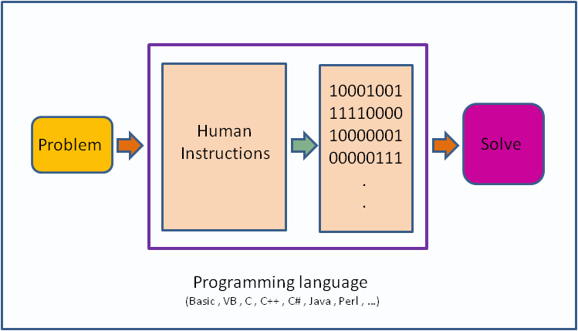

Slide 9
Its nearly impossible to write in
Binary!

Slide 10
So we use programminglanguage with Flowcharts & Algorithms for solving a Problem

Slide 11
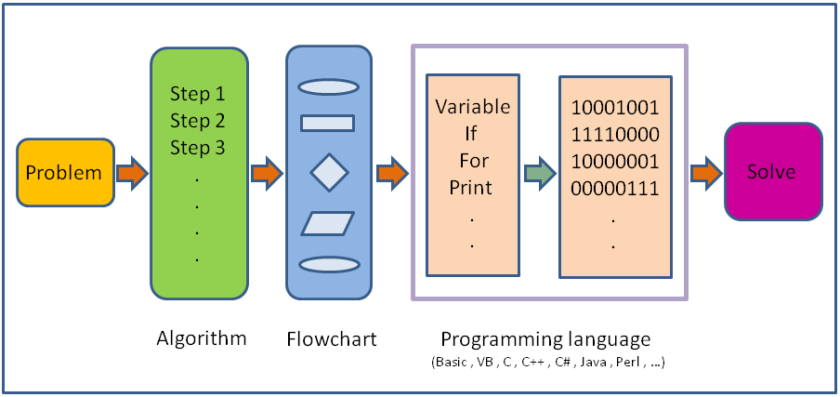

Slide 12
What is programming language?
 A programming language is a set of rules that provides a way of telling a computer what operations to perform
 It provides a linguistic framework for describing computations.
 A programming language also has words, symbols and rules of grammar.
 The grammatical rules are called syntax

Slide 13




High/Low Level Languages!
C++/ Java/ Python
Assembly language
Machine Code
ARM/MIPS/IBM

Slide 14





How do we work with High Level?
Magic Box
Compiler
000000 00001
00010 00110
00000 100000
sum =I+j;
Linker
In High level
In Machine Code

Slide 15
Before we write a program for a solution we need an Algorithm.

Slide 16
So what is an algorithm?
 An algorithm is a self-contained step by step set of operations to be performed in order to solve a problem.
 Its an effective method that can be expressed within a finite amount of space and time and in well-defined formal
language for solving a problem.
 Another way to describe an algorithm is a sequence of unambiguous instructions.

Slide 17
Expressing Algorithms?
 Algorithms can be expressed in many kind of notations, including natural languages,
pseudocode, flowcharts, etc.
 Natural Language expressions of algorithms tend to be verbose and ambiguous, and are rarely used for complex or technical algorithms.
 Programming languages are primarily intended for expressing algorithms in a form that can be executed by a computer.

Slide 18
Two basicaspects of programming
 Data
 Instructions

Slide 19
To understand data we need to understand Variables!

Slide 20
What are Variables?
 Variables in a computer program are analogous to Buckets or Envelopes where information can be maintained and referenced.
 On the outside of the bucket is a name.
 When referring to the bucket, we use the name of the bucket, not the data stored in the bucket.

Slide 21
Variable Actions!
 Create one (with a nice name). A variable should be named to represent all possible values that it might contain. Some examples are: midterm_score, midterm_scores, data_points, course_name, etc.
 Put some information into it (destroying whatever was there before). We "put" information into a variable using the assignment operator, e.g., midterm_score =93;
 Get a copy of the information out of it (leaving a copy inside). We "get" the information out by simply writing the name of the variable, the computer does the rest for us, e.g., average = (grade_1 +grade_2) / 2.

Slide 22
What are instructions?
 Its an order given to computer.
 At lowest level each of these is a sequence of 0s and 1s.
 In assembly language, each statement is one instruction but in high level each statement can be further broken into multiple steps.

Slide 23
Six basic computer instructions
Reading/Receiving some information
Outputting/Printing some information
 Performing arithmetic operation
 Assigning a value to a variable or memory location
 Conditional Execution
 Repeat a group of actions

Slide 24
Time for Flowcharts!

Slide 25
What is a flowchart?
 Diagrammatic representation illustrating a solution to a given problem.
 Allows you to break down any process into smaller steps and display them in a visually pleasing way
 It shows steps as boxes of various kinds, and their order by connecting them with arrows.
 It helps your audience to see the logical flow and relationship between steps.

Slide 26





Flowchart components
Start
Initializer / Terminator
Read N
Input / Output
Let Sum =0, I=1
Process
IsI greater than N ?
Decision
Arrow
A
Connector

Slide 27
Lets look at few problems and their flowcharts!

Slide 28




Read Principal, Rate & Time and Print SI
Start
Read P, R, T
SI=(P*R*T)/100
Output SI End

Slide 29




Find largest of threenumbers
Start
Read A,B,C
IsA >B
and A >C
No
IsB > A
and B
>C
Yes
Print A
Yes
Print B
No
Print C
End

Slide 30


Read a & d, print 10 numbers of form a+d, a+2d, a+3d…
Start
Read a, d
Let I=1
Yes
I=I+1
IsI<=10
Output term
No
End
term =a +I*d

Slide 31
Given N, print all numbers from 1 to N
Start
Read N
Let I=1
Add 1 to I
Yes
IsI<=N ?
Output I
No
End

Slide 32
Time to try?
 Read five numbers and print their average
 Given N, find sum of even numbers from 1 to N
 Given N, check if its prime or not

Slide 33



Check if a number is prime or not?
Start
Read N I =2
Is I < N ?
No
Print “ISPRIME”
Add 1 to I
Yes
No
IsN divisible by I?
Yes
Print “NOT PRIME”
End

Slide 34
Some more examples!

Slide 35

Find largest of N numbers
Start
Read N
Let I=1, L =-1000000
IsI<=N ?
No
Output L
Add 1 to I
Yes
Read Num
End
No
IsNum > L ?
L =Num
Yes

Slide 36


Print the below pattern
*
Start
**
***
****
*****
I=I+1
Read N
Print ‘\n’
Let I=1
J =J +1
No
IsI<=N ?
Print ‘*’
Yes
Yes
No
Let J =1
IsJ <=I ?
End

Slide 37
Time to try?
 Given a list of N integers, find mean, maximum and minimum value. You would be given first N, and then N integers of the list.
 Given a number check if it is a member of Fibonacci sequence ornot
 Read N, and print the following pattern
1
2 3
4 5 6
7 8 9 10
11 12 13 14 15

Slide 38
Time for Brain Teasers!

Slide 39
BT– 2: Apples and Oranges
There are three closed and opaque
cardboard boxes. One is labeled "APPLES", another is labeled "ORANGES", and the last is labeled "APPLES AND ORANGES". You know that the labels are currently misarranged, such
that no box is correctly labeled. You would like to correctly rearrange these labels. To accomplish this, you may draw only one fruit from one of the boxes. Which box do you choose, and how do you then proceed to rearrange the labels?

Slide 40
BT – 3: Average Salary
Three coworkers would like to know their average salary. However, they are self- conscious and don't want to tell each other their own salaries, for fear of either being ridiculed or getting their houses robbed. How can they find their average salary, without disclosing their own salaries?

Slide 41
Pseudocode!

Slide 42
What is pseudocode?
 A notation resembling a simplified programming language, used in program design
 It allows designers or lead programmers to express the design in great detail and provides programmers a detailed template for the next step of writing code in a specific programming language

Slide 43
Notation for those basic six!
 Reading/Receiving [ read N ]
 Outputting/Printing [ print Sum, print “Coding Blocks”, print 1, print ‘\n’ ]
 Assignment [Sum ← 5]
 Arithmetic operators [ a+b, a *5, sum +i ]
 If Else [ if I< N then … else then … endif ]
 While Loop [ while I< N do … endwhile ]

Slide 44
Lets convert some flowchartsinto pseudocode!

Slide 45
Check if a number is prime or not?
Start
Read N I =2
Is I < N ?
No
Print “ISPRIME”
Add 1 to I
Yes
No
IsN is divisible by I?
Yes
Print “NOT PRIME”
End

Slide 46
Pseudocode- Check if N is prime?
read N I← 2
While I<N do
if N is divisible by Ithen
print “NOT PRIME” exit
endif I← I+1
endwhile
print “IS PRIME” exit

Slide 47
Find largest of N numbers
Start
Read N
Let I=1, L =-1000000
IsI<N ?
No
Output L
Add 1 to I
Yes
Read Num
End
No
IsNum > L ?
L =Num
Yes

Slide 48
Pseudocode –Largest of N numbers
read N
I← 1, L ← -100000
while I<N do
read num
if num >L then
L ← num
endif I← I+1
endwhile
print L exit

Slide 49
Lets try one more pattern!
1
123
12345
1234567
123456789
read N
i ← 1
while i <=N do
j← 1
while j<=n-i do
print ‘ ‘ j← j+1
endwhile
j← 1, value ← 1 while j<=2*i - 1 do
print value j← j+1
value ← value +1
endwhile print ‘\n’ i ← i +1
endwhile exit

Slide 50
Time to try?
 Convert your flowcharts into pseudocode
 Read N and print the below pattern
1
232
34543
4567654
567898765
III.Given a number N, find sum of its digits

Slide 51
BT – 4: Criminal Cupbearers
An evil king has 1000 bottles of wine. A neighboring queen plots to kill the bad king, and sends a servant to poison the wine. The king's guards catch the servant after he has only poisoned one bottle.
The guards don't know which bottle was poisoned, but they do know that the poison is so potent that even if it was diluted 1,000,000 times, it would still be fatal. Furthermore, the effects of the poison take one month to surface. The king decides he
will get some of his prisoners in his vast dungeons to drink the wine. Rather than using 1000 prisoners each assigned to a particular bottle, this king knows that he needs to murder no more than 10 prisoners to figure out what bottle is poisoned, and wil stil be able to drink the rest of the wine in 5 weeks time. How does he pull this off?

Slide 52
What is next class about?

Slide 53
Programming Fundamentals -1
 Basic syntax of C++
 Datatypes/Variables
 Constants
 Ifelse
 while

Slide 54
Thank You!
kartik.mathur@codingblocks.com
+91-9560196180

